Slide 1
Traffic Congestion Management
A Smart City Application

Slide 2
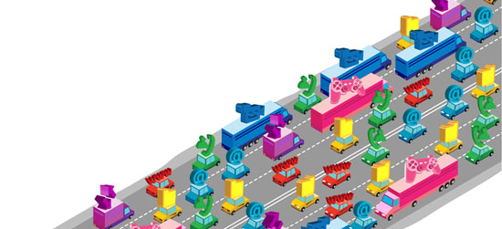
Todays major problem: Traffic Congestion

Slide 3
Problem Statement:
Public transportation available for the common people gets delayed due to traffic congestion. Common people who rely on public transportation have to suffer cause of that.

Slide 4
Proposed Solution:
By controlling the reasons causing traffic congestion we can improve public transportation. Some of the solutions are,
1) Operating Existing Capacity More Efficiently – Getting More Out of What We Have.
2) Adding More Capacity – Increasing the Number and Size of Highways and Providing More Transit and Freight Rail Service.
3) Encouraging Travel and Land Use Patterns that Use the System in Less Congestion Producing Ways.

Slide 5
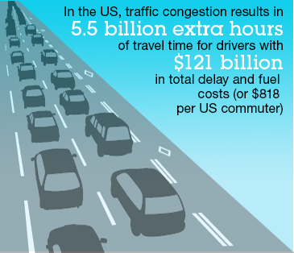
Lets see each one in detail

Slide 6
1) Operating Existing Capacity More Efficiently
Transferring traffic onto freeways;
Optimizing the timing of traffic signals;
Faster and anticipatory responses to traffic incidents;
Providing travelers with information on travel conditions as well as alternative routes and modes;
Improved management of work zones;
Identifying weather and road surface problems and rapidly targeting responses;
Better freight management, especially reducing delays at border crossings;
Reversible commuter lanes;
Movable median barriers to add capacity during peak periods;
Restricting turns at key intersections;
Geometric improvements to roads and intersections;
Converting streets to one-way operations.

Slide 7
2) Adding More Capacity
Adding travel lanes on major freeways and streets (including truck climbing lanes on grades);
Removing bottlenecks;
Overpasses or underpasses at congested intersections;
High-occupancy vehicle (HOV) lanes.

Slide 8
3) Encouraging Travel and Land Use Patterns
Programs that encourage transit use and ridesharing;
Curbside and parking management;
Flexible work hours;
Telecommuting programs;
Bikeways and other strategies that promote non-motorized travel;
Pricing fees for the use of travel lanes by the number of persons in the vehicle and the time of day;
Pricing fees for parking spaces by the number of persons in the vehicle, the time of day or location;
Land use controls or zoning;
Growth management restrictions such as urban growth boundaries;
Development policies that support transit-oriented designs for homes, jobsites, and shops; and
Incentives for high-density development, such as tax incentives.

Slide 9
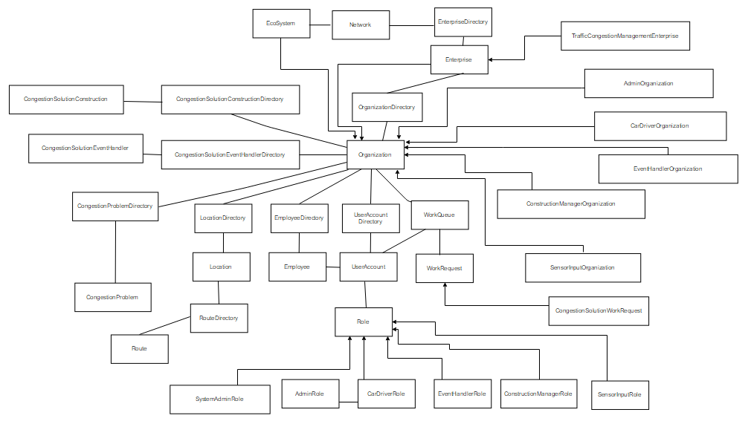
Object Model

Slide 10
Key Roles:
System Admin Role:
Responsibilities: Manages the entire System. Will create various enterprises and their respective admins.
Enterprise Admin Role:
Responsibilities: Manages the enterprise. Will create various Organizations and Employees.
Car Driver Role:
Responsibilities: Manages the Car Driver Organization. Basically he is the one who informs if there is any Congestion.

Slide 11
Key Roles:
Event Handler Role:
Responsibilities: Manages the Event Handler Organization. Basically he is the one who handles various Traffic Events.
Construction Manager Role:
Responsibilities: Manages the Construction Manager Organization. Basically he is the one who handles various Construction related events.

Slide 12
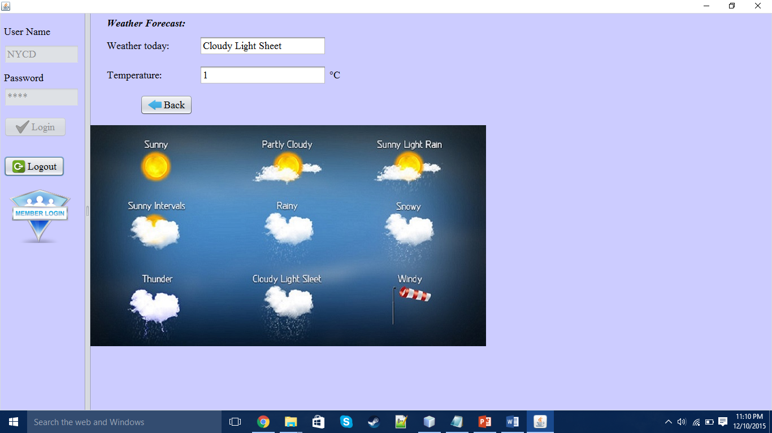
Key features: 1)Weather Forecast

Slide 13
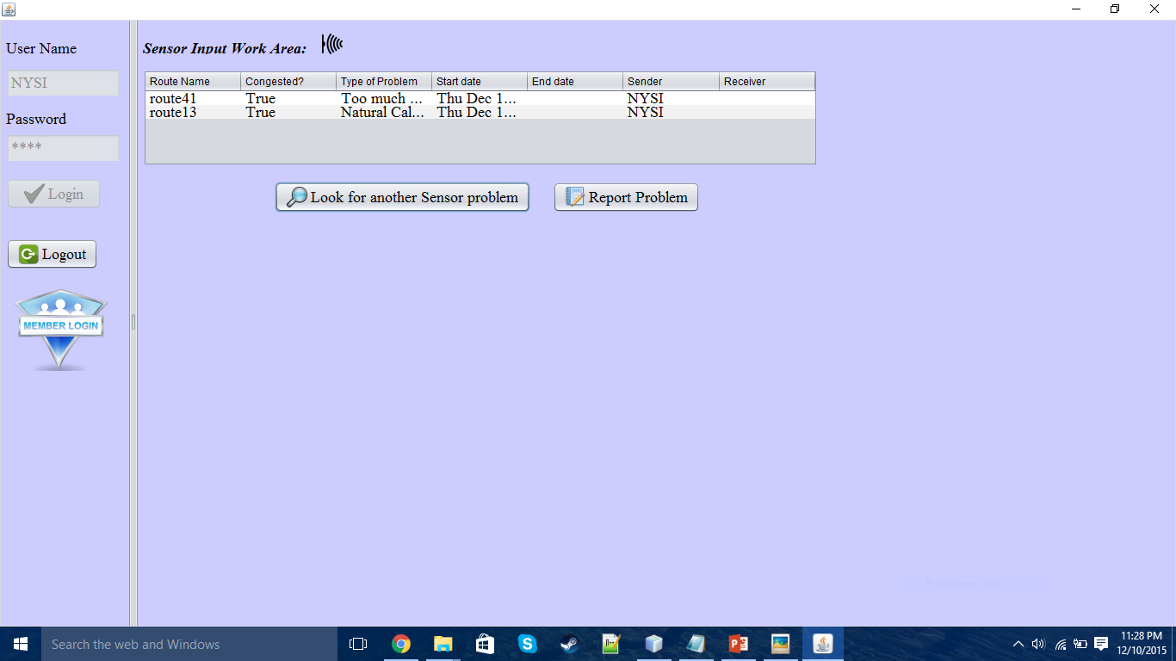
Key features: 2)Sensor Input

Slide 14
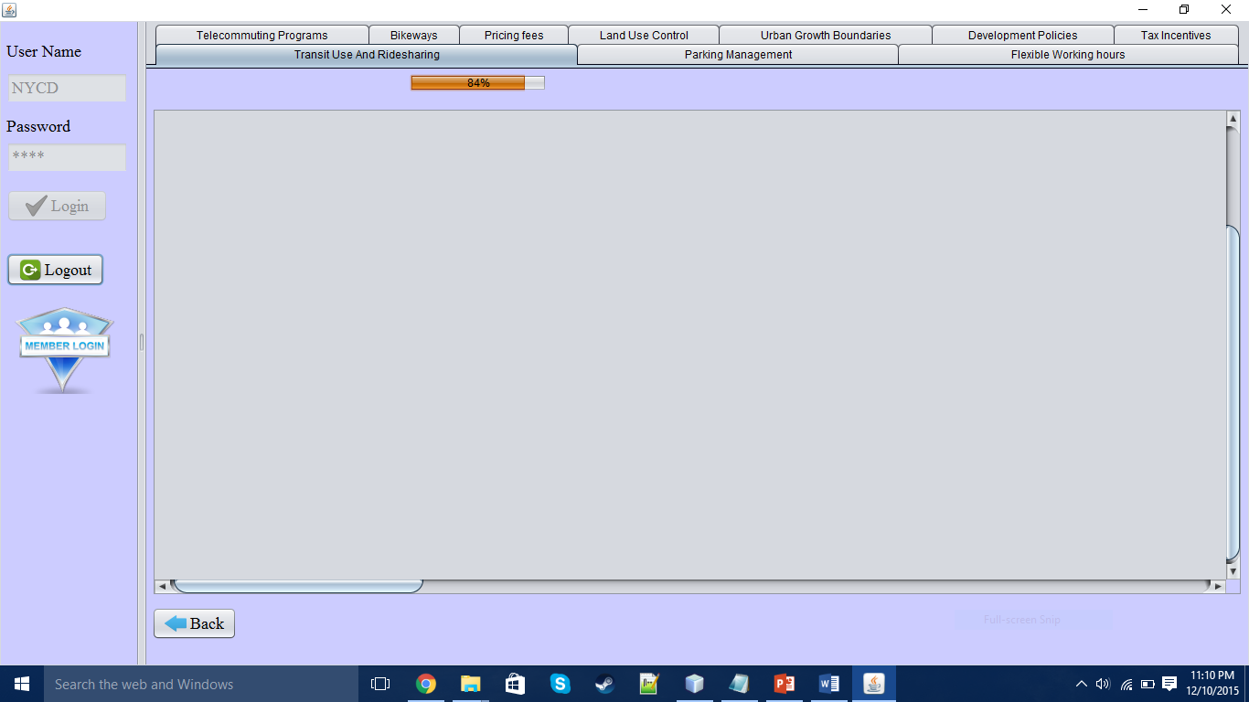
Key features: 3)Information tabbed pane

Slide 15
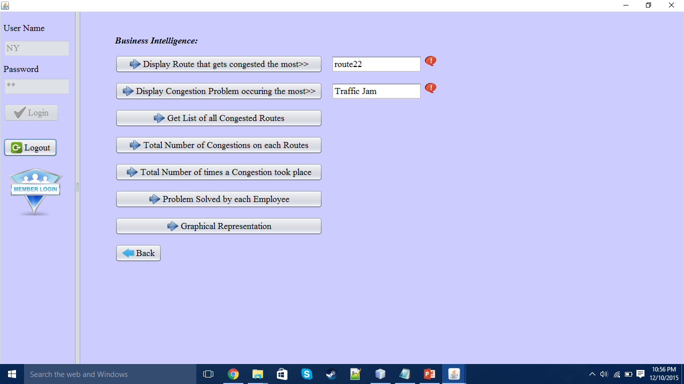
Key features: 4)Business Intelligence

Slide 16
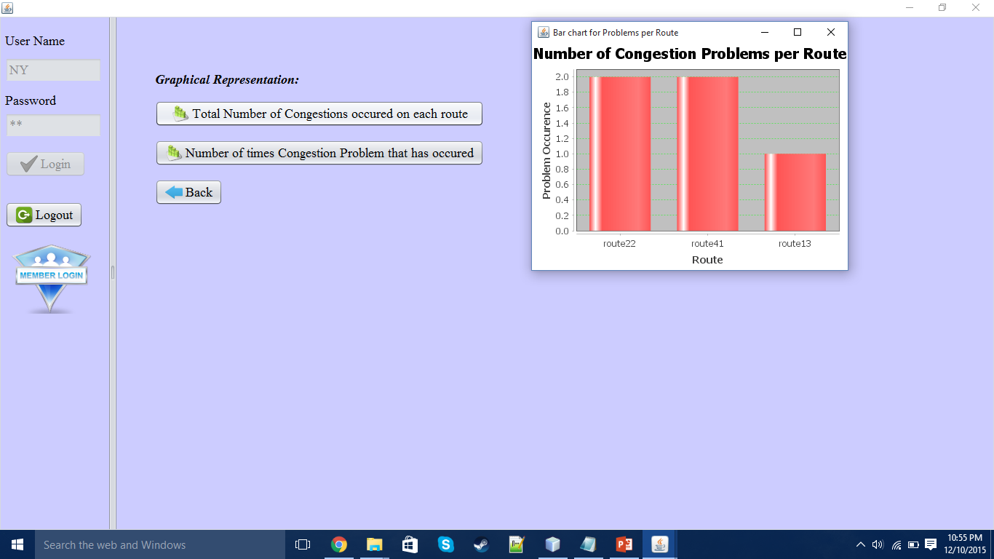
Key features: 5)Graphical Representation

Slide 17
Future Scope:
This application can be expanded a lot.
Huge scope exists in implementation of various Organizations within an enterprise.
In future it can be used for betterment of public transportation.
IOT can be used to detect the demand of public transportation at specific locations and then with the help of censors public transportation schedule can be made dynamic.
Application can also be expanded for reverse direction as well.
If developed properly, application will be very useful in reducing the amount of Traffic Congestion.
Drivers can decide to select a path or not based on Weather and Traffic Congestion present on that path.

Slide 18

Thank You

